Slide 1
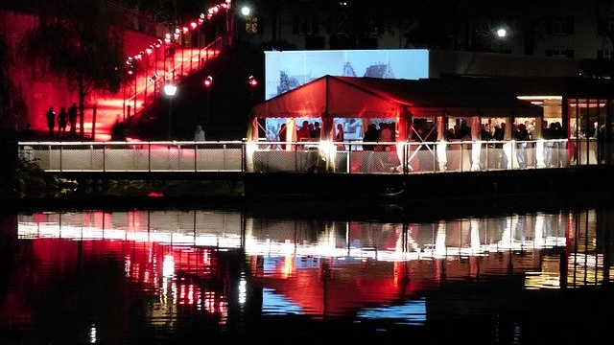
Women Tech Women Yes Summer Gala Engagement
Street Team Placement
Chuck Cao
Chris Chan
Humza Khan
Joshua Mailman

Slide 2
Agenda
Objective
What We Did
Results
Recommendations
Future Work

Slide 3
Objective
Optimize street team placement to gather names and email addresses of those who will attend gala and contribute to cause.

Slide 4
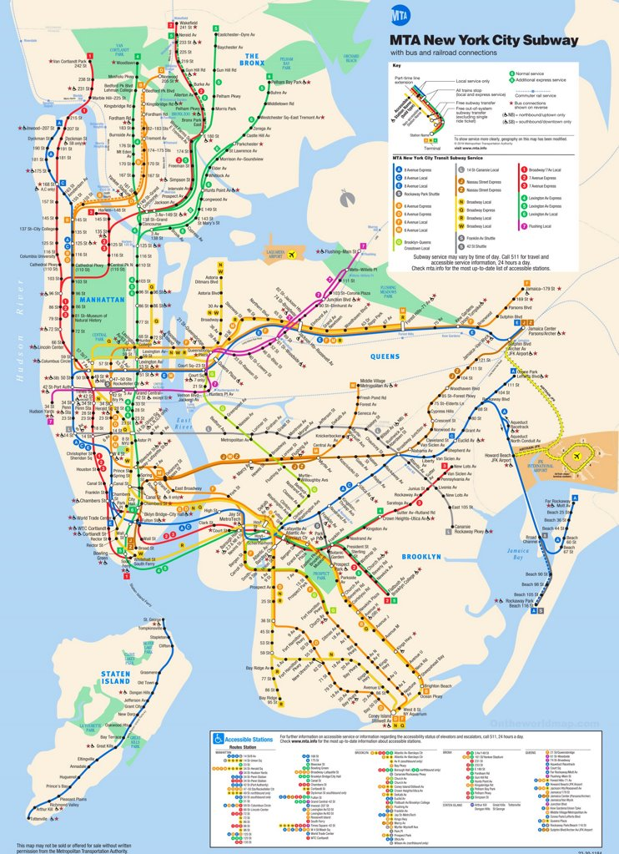
What We Did
Four weeks of July 2019 MTA turnstile data
472 Stations
20.7M NYC metro area residents
Pandas, matplotlib, seaborn

Slide 5
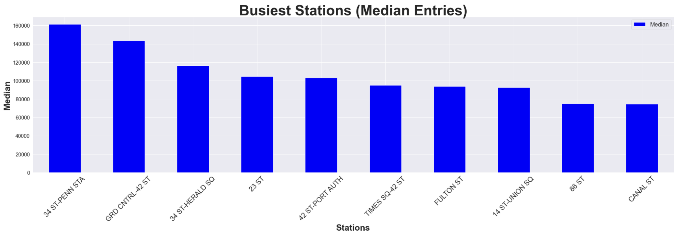


Slide 6
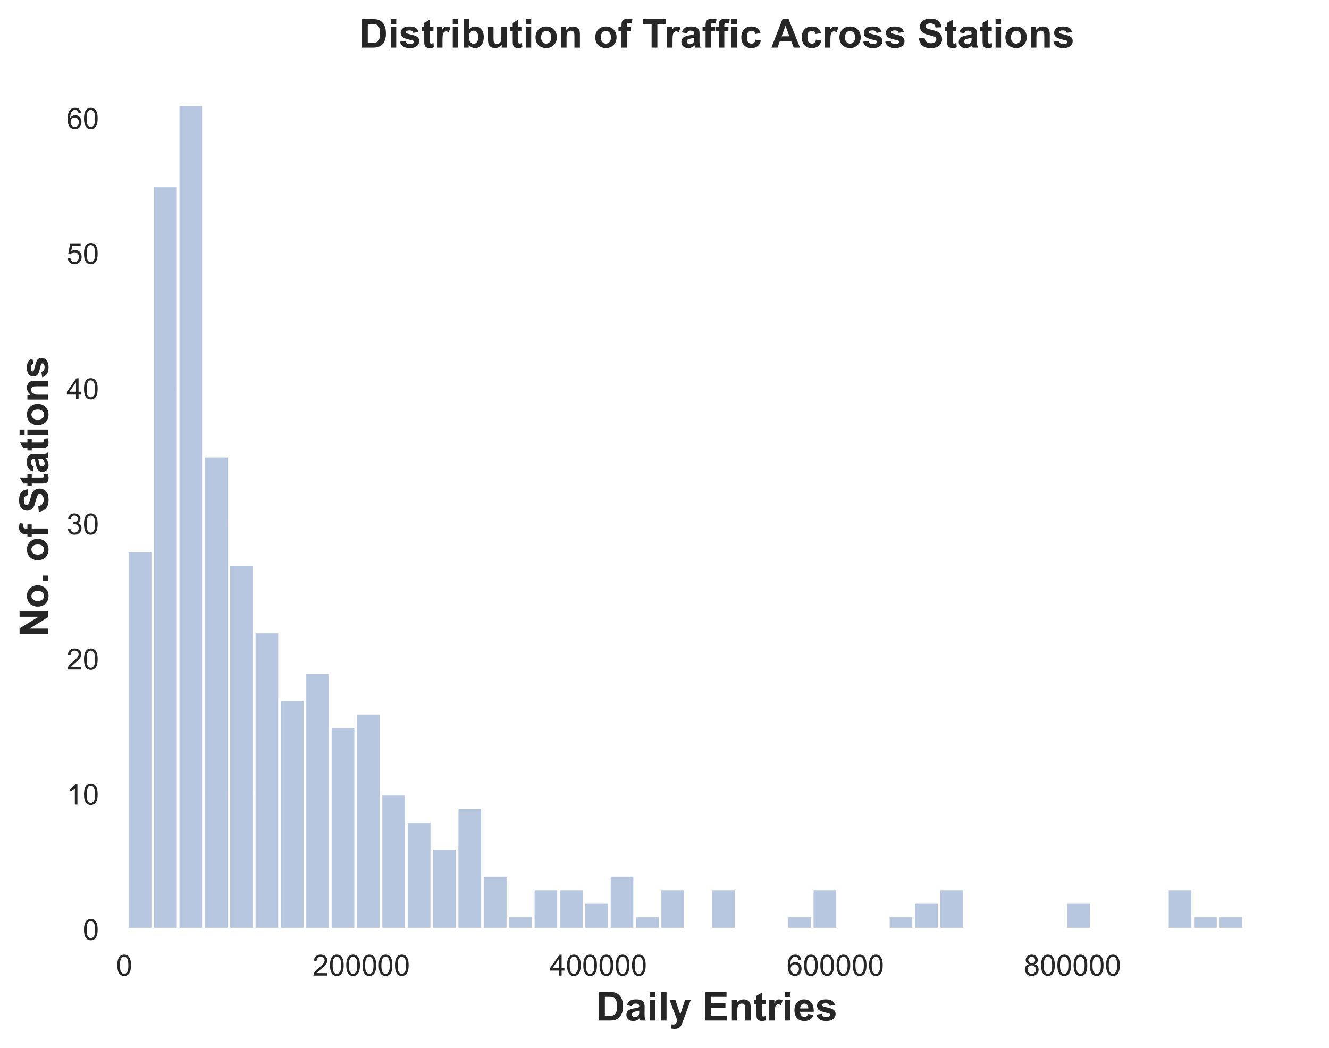

Slide 7
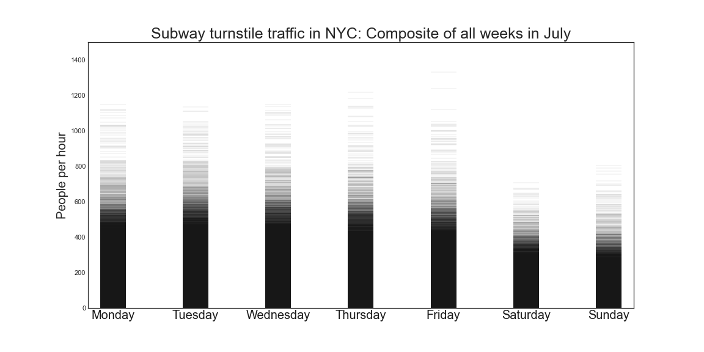
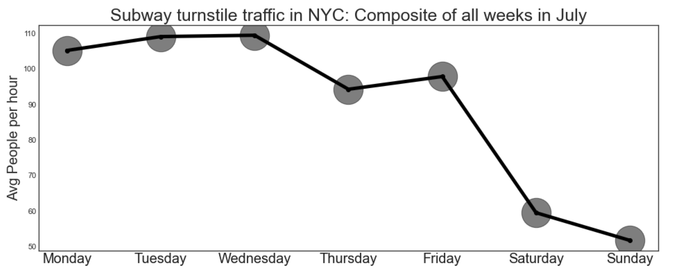
Turnstile Fluctuation By Day

Slide 8
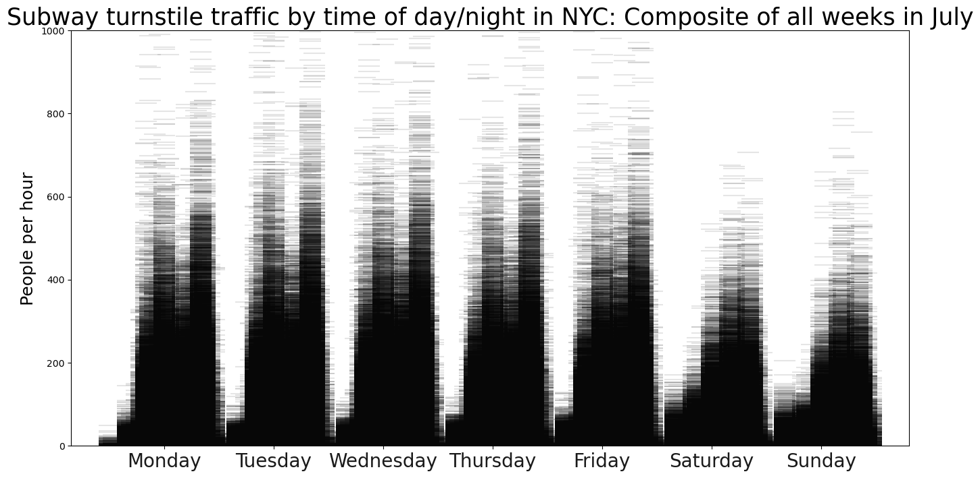
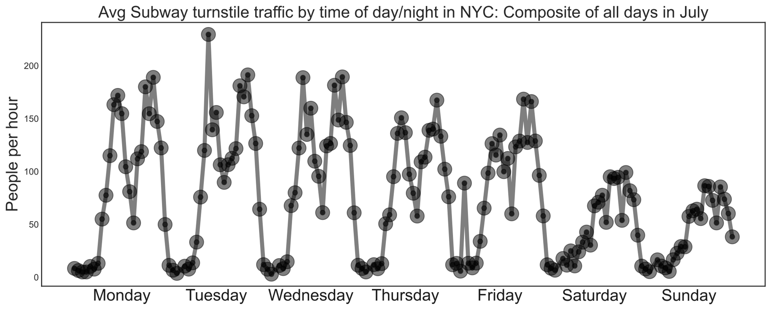
Turnstile Fluctuation By Time During The Week

Slide 9
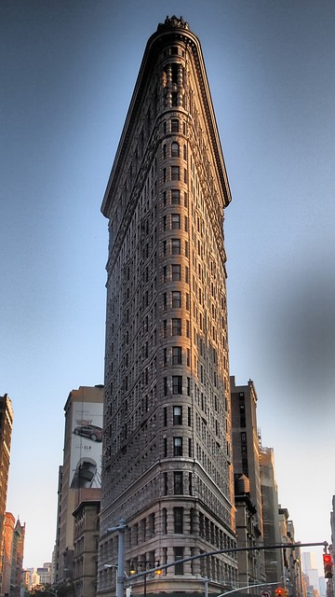
Location, Location, Location

Slide 10
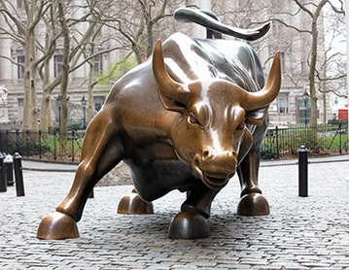
Show me the Money!
Top 10 Subway Stations by Household Income
Top 10 Subway Stations by Household Income

Slide 11
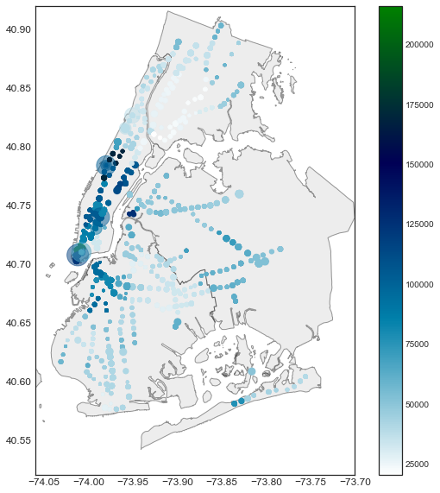
Median Household Income by NYC Subway Locations

Slide 12
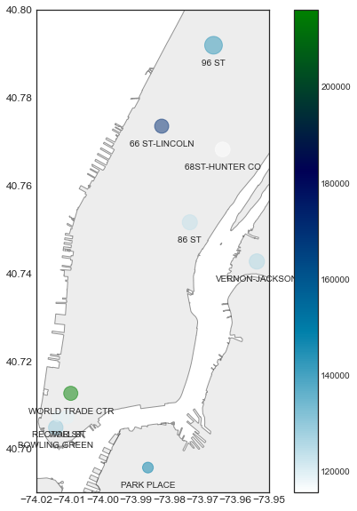
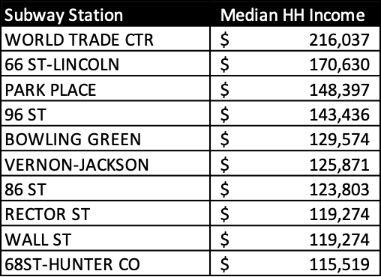
Top 10 Subway Stations by Household Income

Slide 13
Location, Location, Location
The Flatiron district: NYC’s tech hub

Slide 14
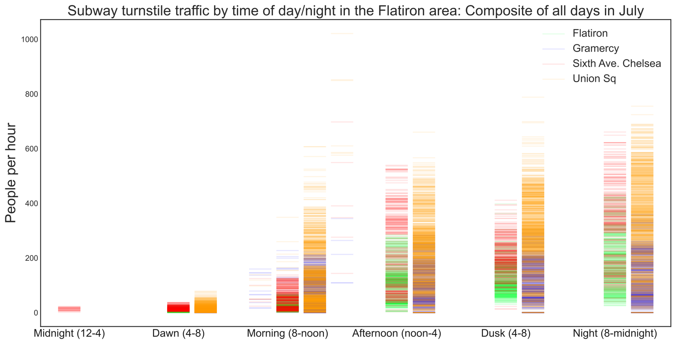
The Flatiron district: NYC’s tech hub

Slide 15
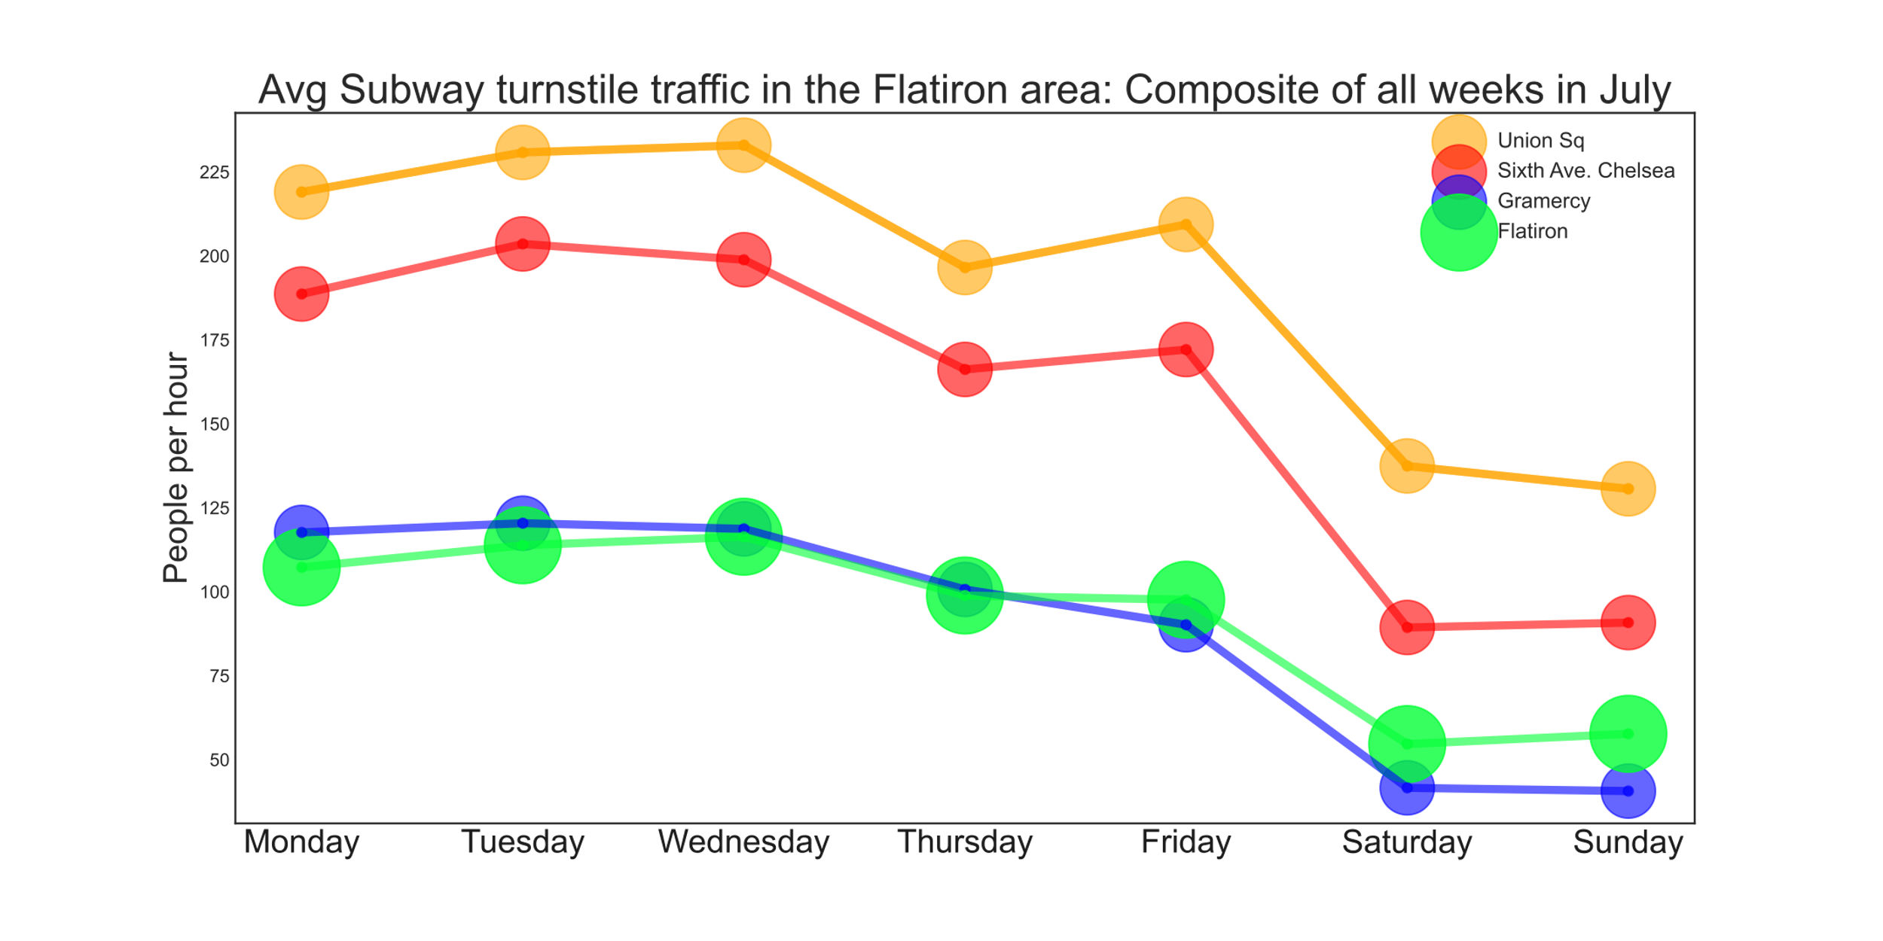
The Flatiron district: NYC’s tech hub

Slide 16
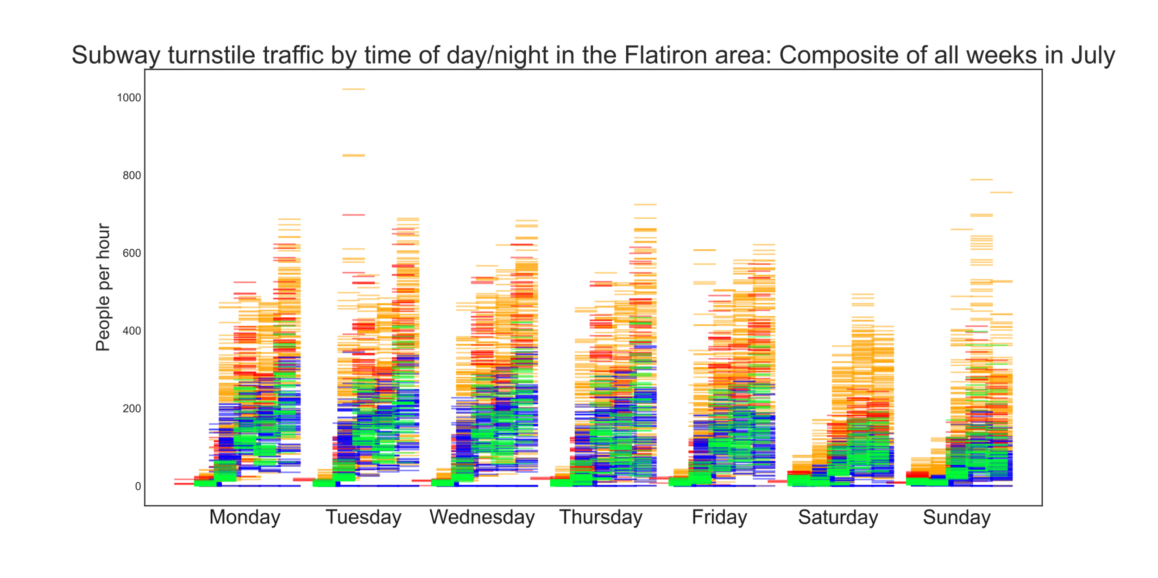
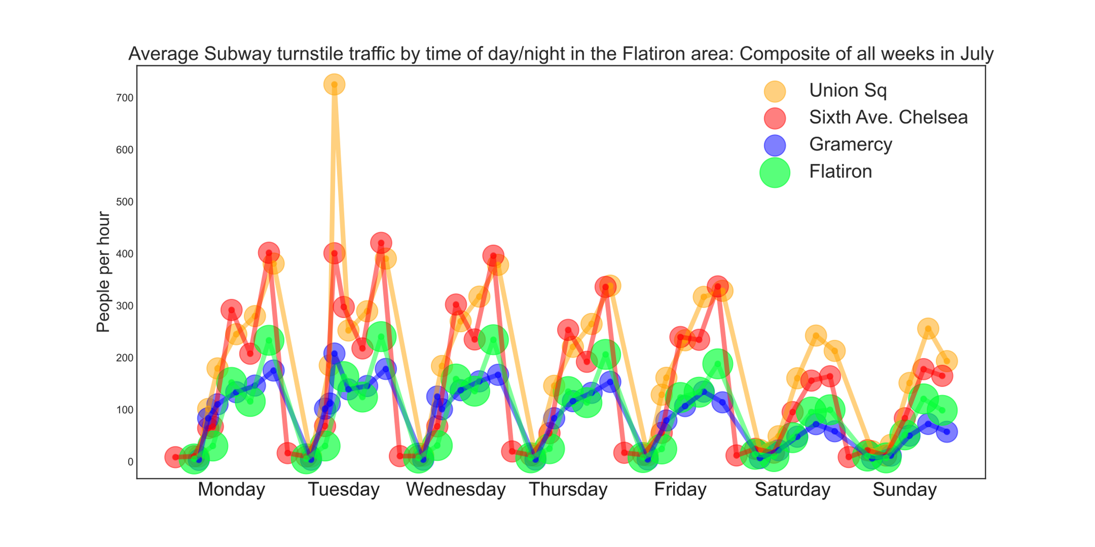
The Flatiron district: NYC’s tech hub

Slide 17
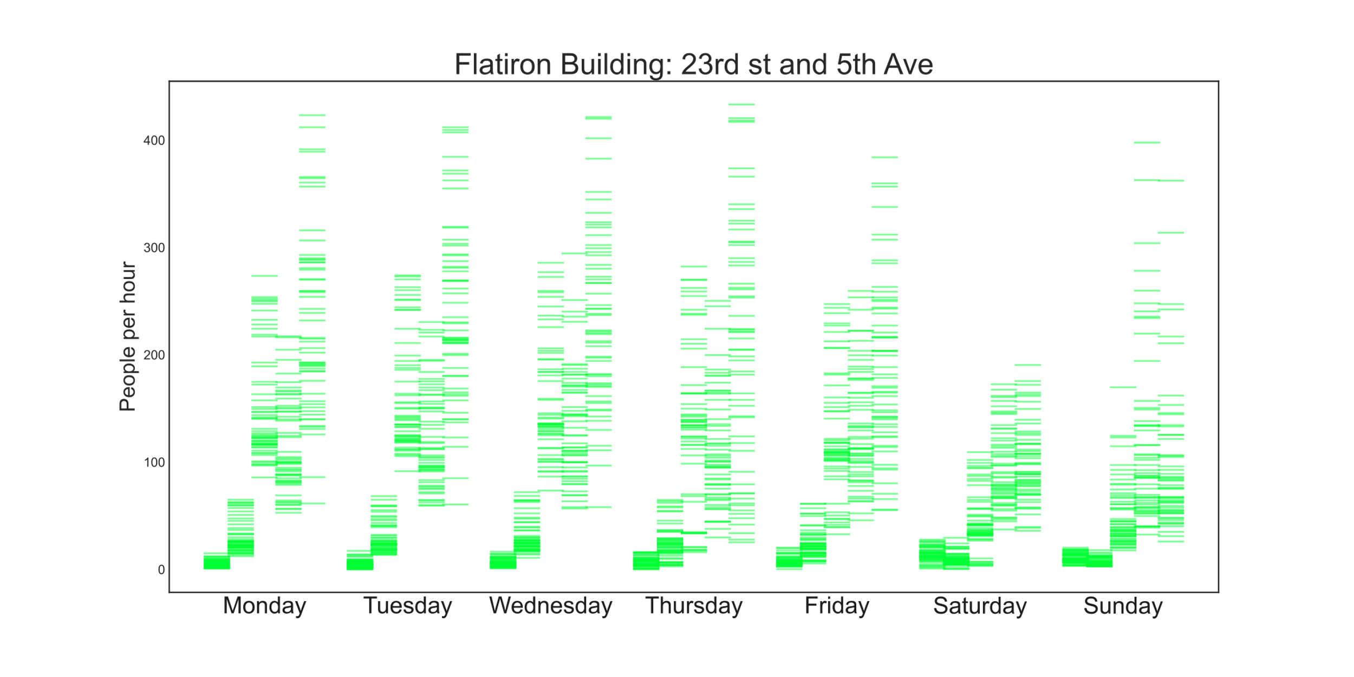
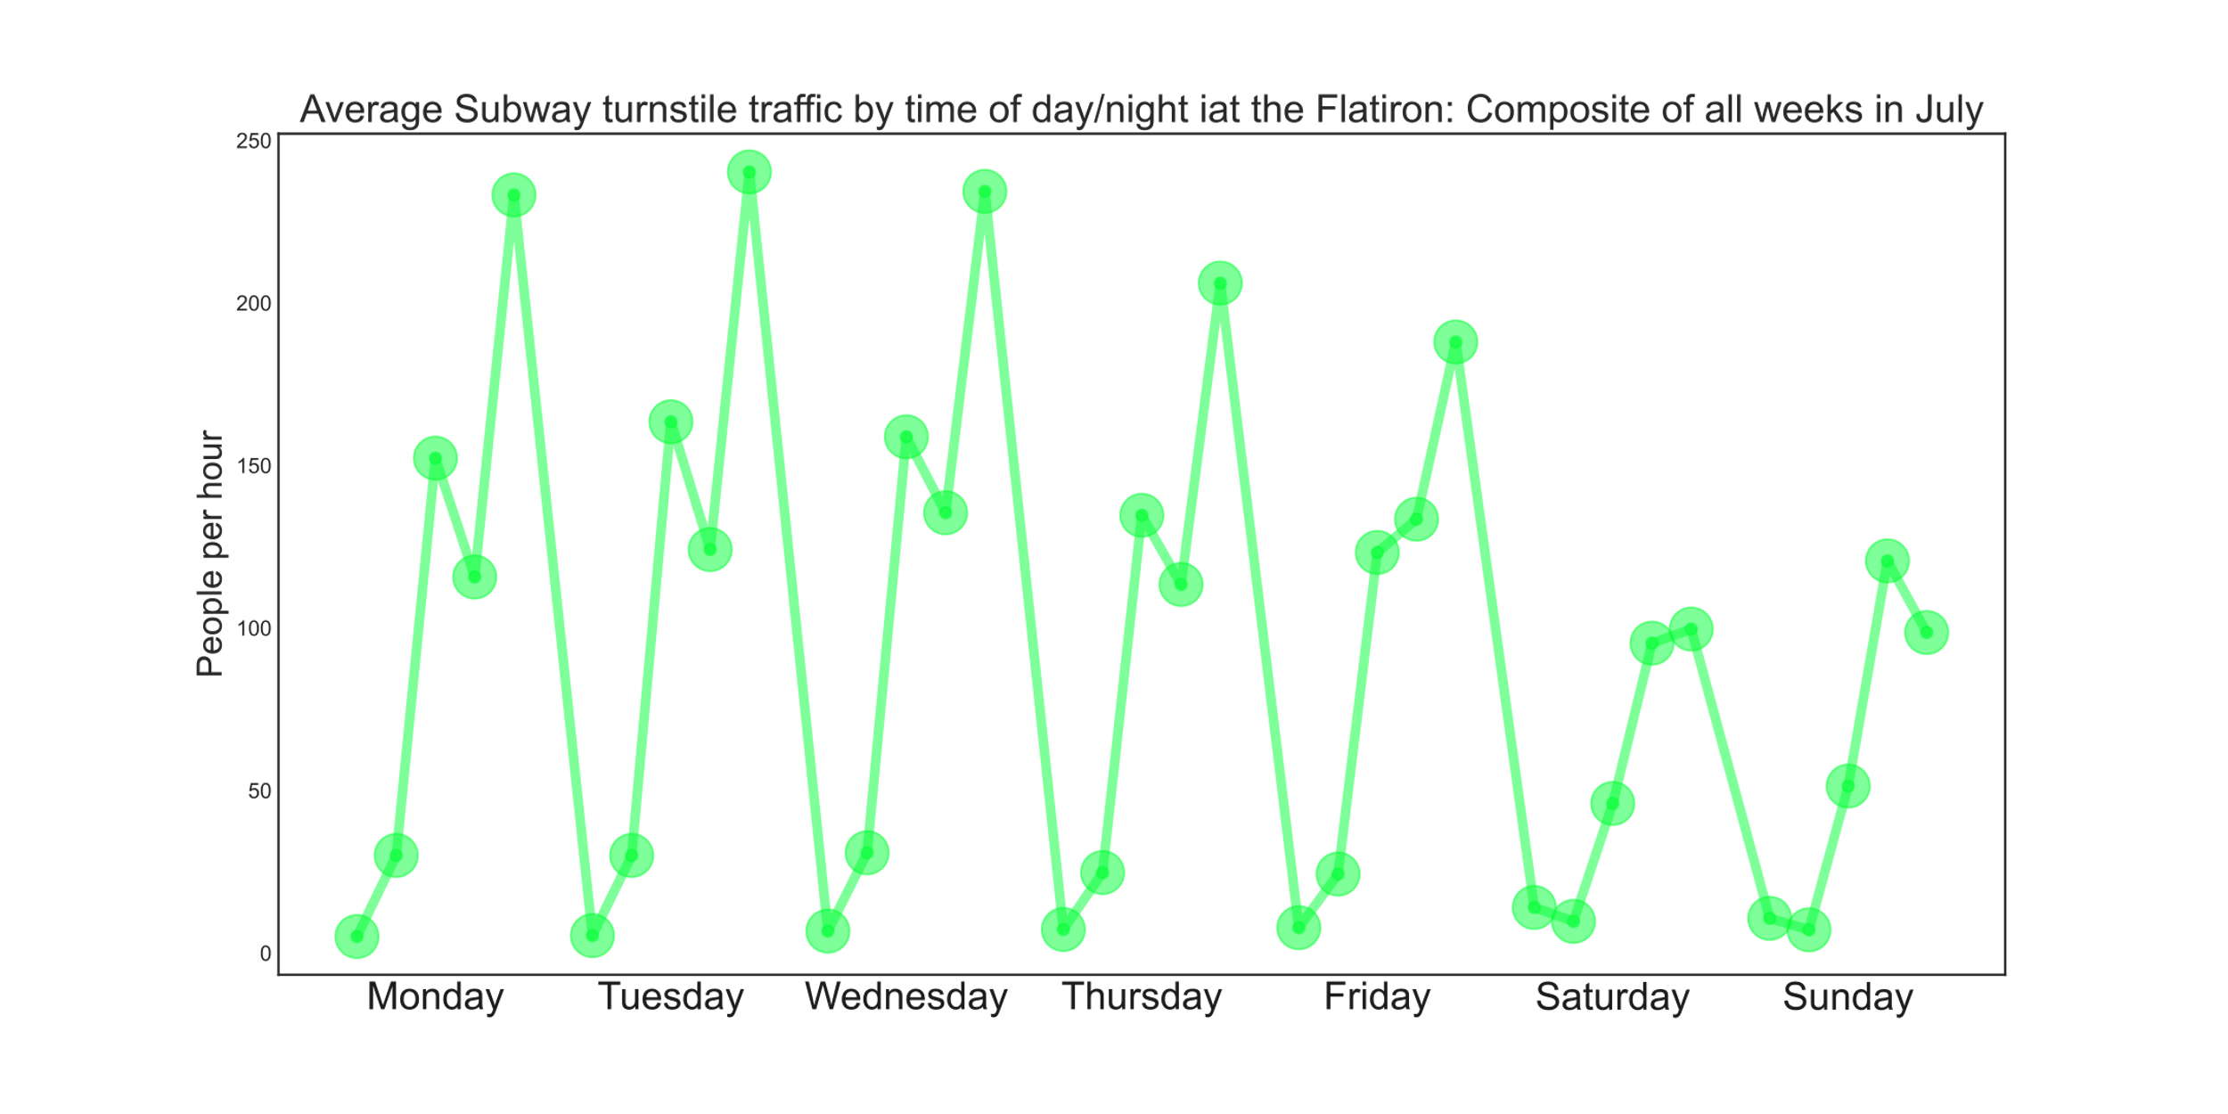
The Flatiron district: NYC’s tech hub

Slide 18
First Recommendation
The Flatiron building subway stop: 23rd and 5th Ave
Flatiron, 23rd st at Broadway and 5th Ave
8pm to midnight , Monday, Tuesday, Wednesday

Slide 19
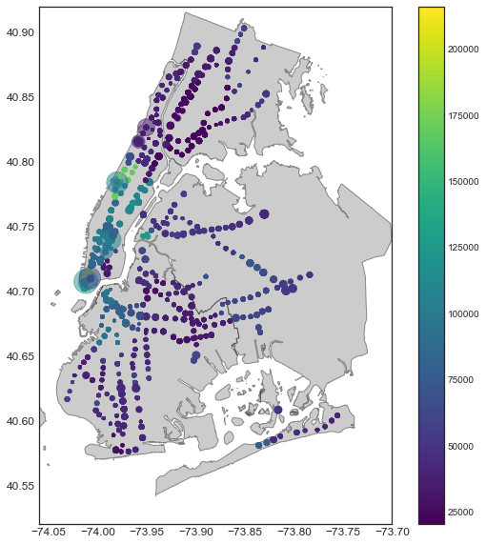
Location, Location, Location
Pursuing a second recommendation,
by focusing on high-income neighborhoods

Slide 20
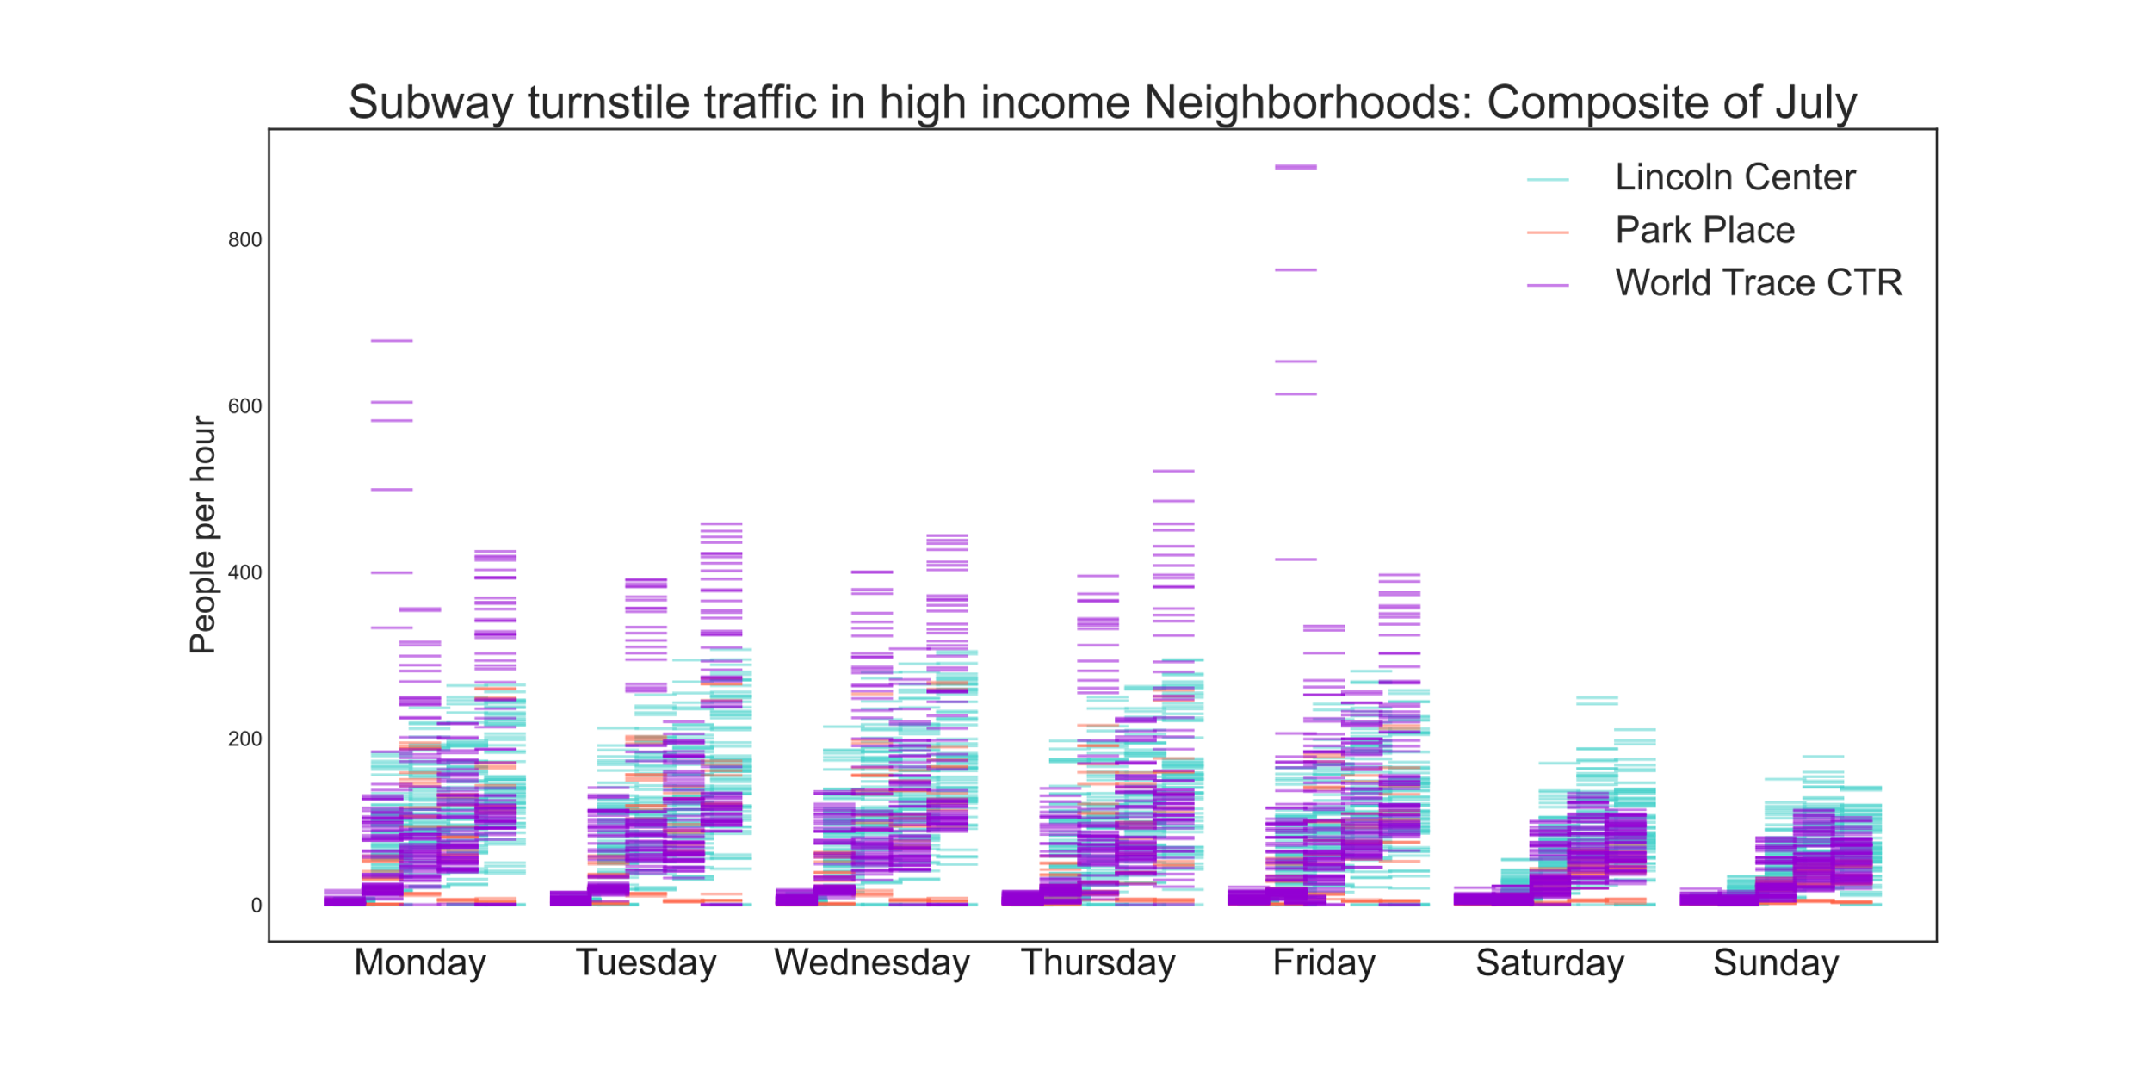
High-income neighborhoods:
• Lincoln Center
• Park Place
• World Trade CTR

Slide 21
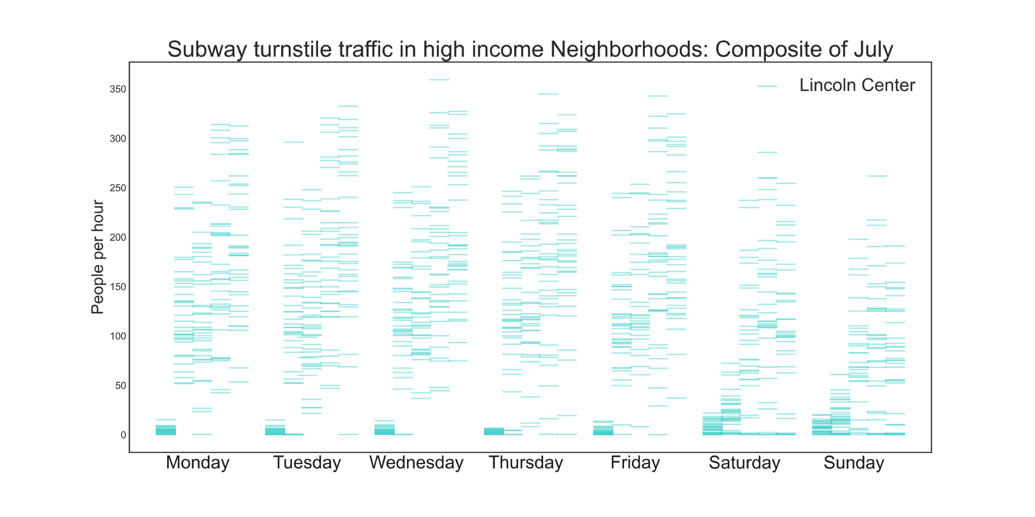
High-income neighborhoods:
• Lincoln Center
• Park Place
• World Trade CTR

Slide 22
Second Recommendation
The subway stop: 66th Street and Broadway, Lincoln Center
Lincoln Center
4pm to midnight , Monday through Thursday

Slide 23
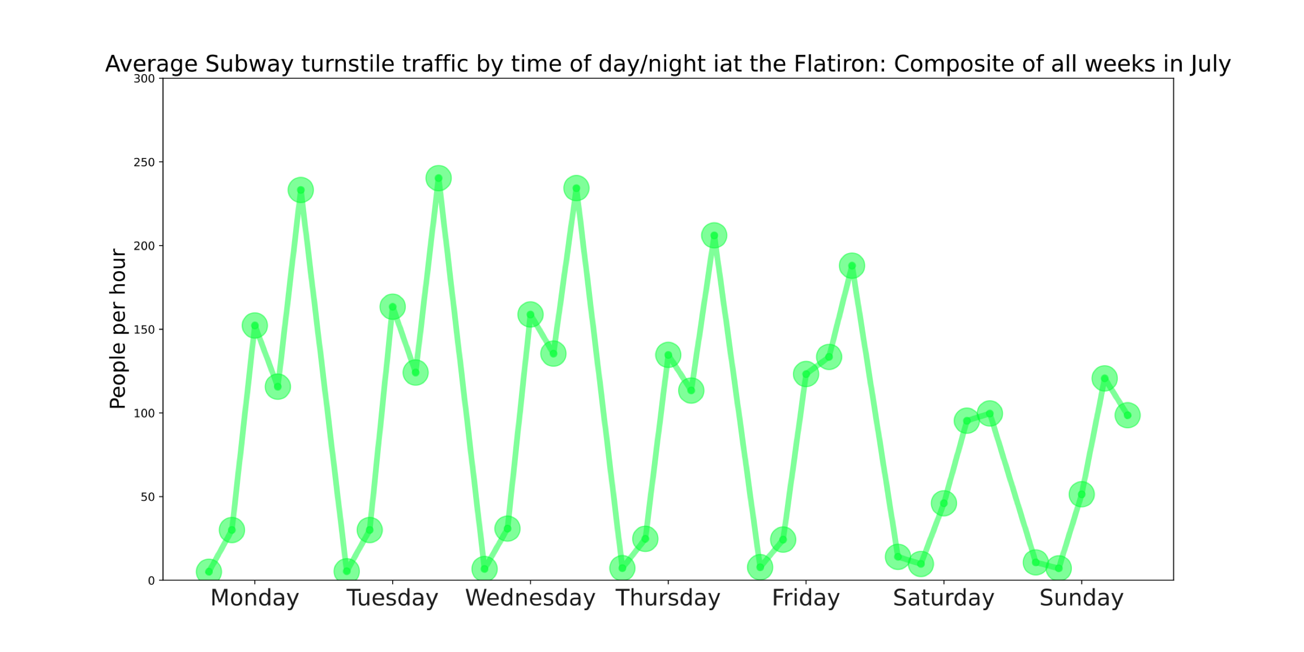
Summary
8pm to midnight ,
Monday,
Tuesday, Wednesday
Flatiron
4pm to midnight ,
Monday through Thursday
Lincoln Center

Slide 24
APPENDIX

Slide 25
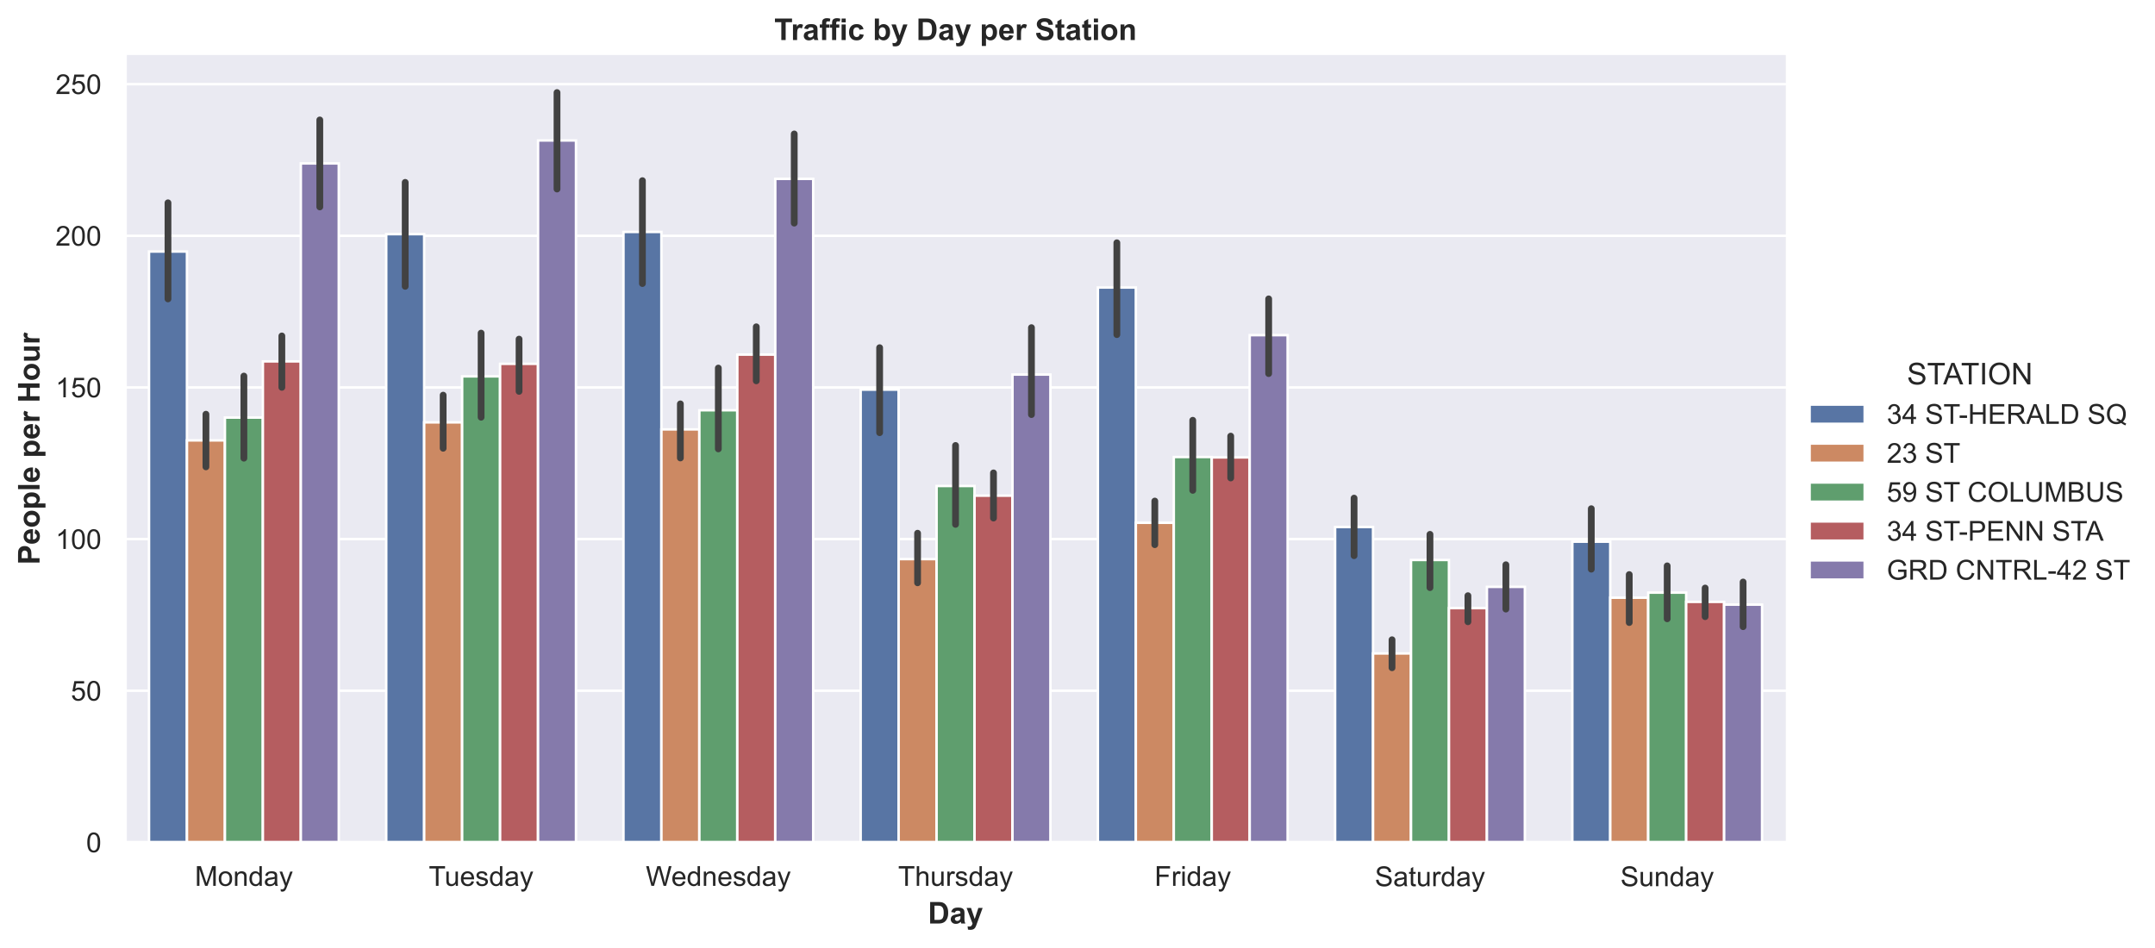

Slide 26
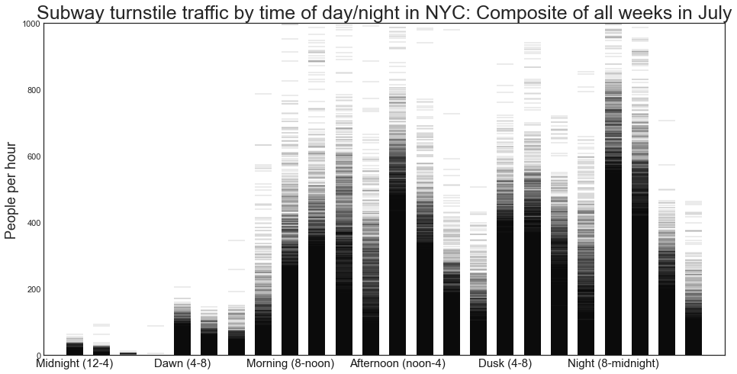
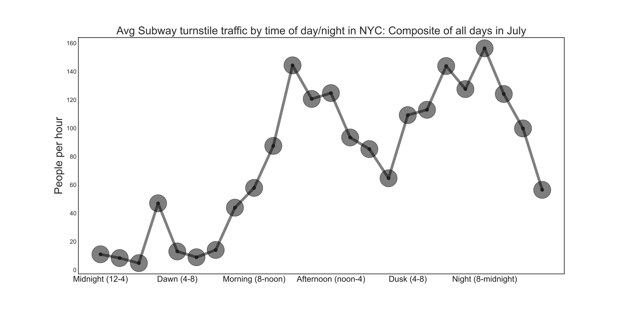
Turnstile Fluctuation By Time of Day

